Slide 1
Verification Environment Specification of APB to BURST Module
S.C. EasyIC Design S.R.L.
Ciomag Andrei Daniel

Slide 2
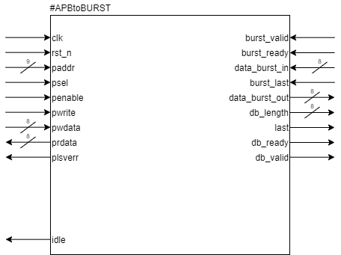
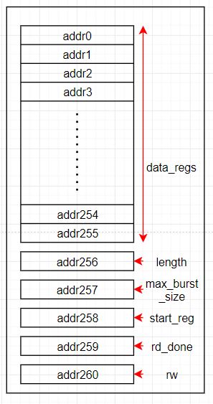
Design Specification – 1 Block Diagram
The APBtoBURST block can make read or write transactions using the burst method. The maximum size for the burst being in the range from 1 to 32 bytes.
Internal Registers

Slide 3
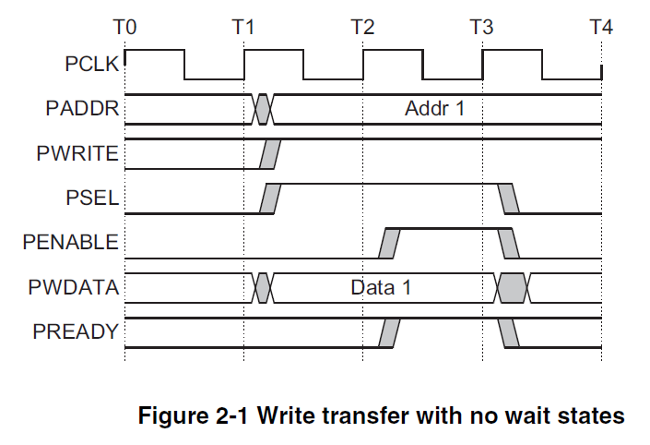
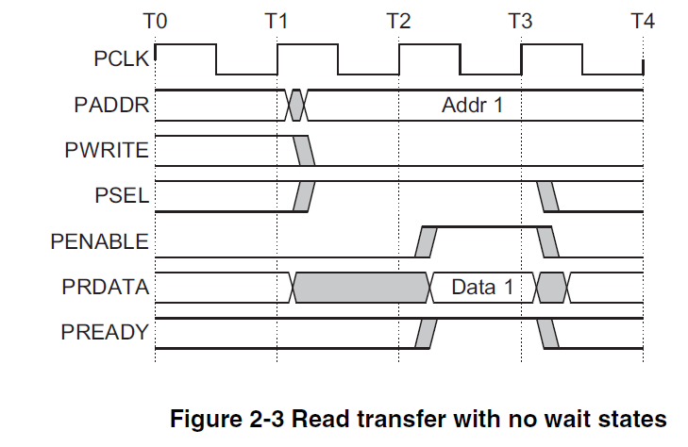
Design Specification – 2 Transactions
A transaction consists of several commands given on the APB bus. There are two types of commands on the APB bus, write and read.

Slide 4
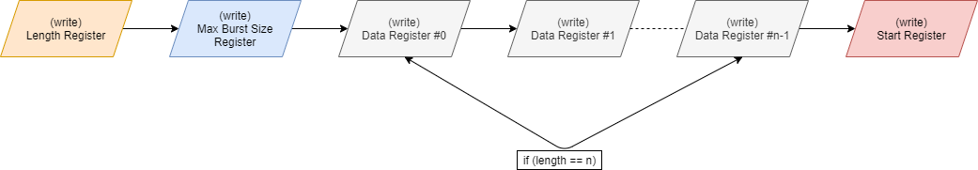
Design Specification – 2 Transactions
Write Transaction

Slide 5
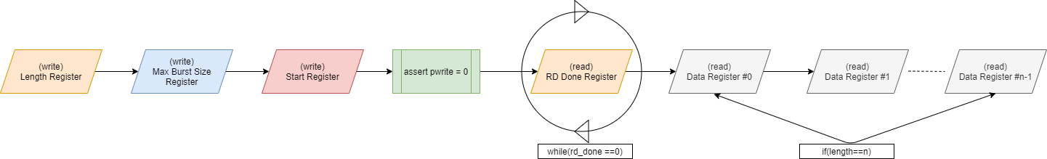
Design Specification – 2 Transactions
Read Transaction

Slide 6
Verification Plan – 1 Stimulus Generation
Write Transaction :
Generate correct or incorrect length value for Length Register configuration
Generate correct or incorrect burst sizes between 1 and 32
Generate write commands on Data Registers ranging from 1 to 255
Read Transaction :
Generate a length value for Length Register configuration
Generate burst sizes between 1 and 32
Generate good or bad** data bursts
*incorrect transaction = the transaction length value is not equal to the number of data registers which were written or/and the number of written data registers is less than the max burst size value
**bad data bursts = the number of data written in the register bank is different from the value in the length register

Slide 7
Verification Plan – 2 Coverage
Cover APB Interface signals values
Cover all good and bad Length Register and Max Data Burst Register configurations
Cover all Data Registers
Cover all good and bad data bursts length
Cover all the above combinations

Slide 8
Verification Plan – 3 Checkers
Checkers for APB Protocol
Checkers for Burst Master and Data Burst Controller hand shaking signals
Checker for Idle Signal

Slide 9
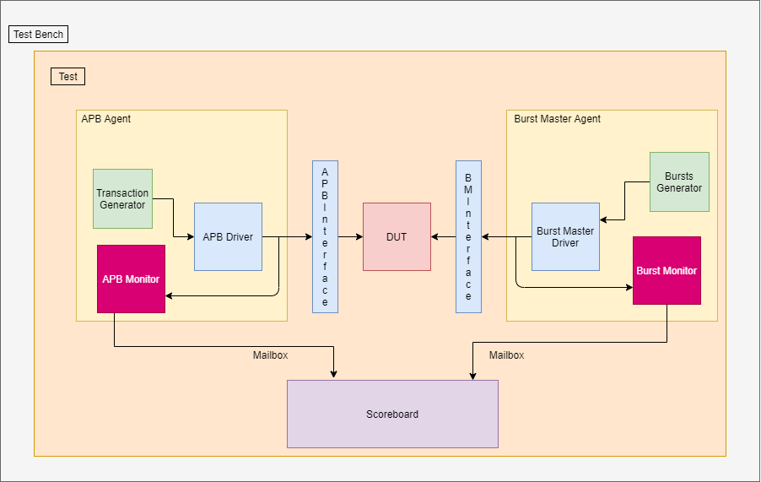
Verification Plan – 4 Verification Environment

